Slide 1
Apache Hadoop – A Developer’s Course
An introduction to Big Data

Slide 2
What defines Big Data?
Volume
Petabytes and exabytes (10¹⁵ bytes = 1 petabyte, 10¹⁸ bytes = 1 exabyte)
Variety
Any type of data (text, XML, binary, structured, un-structured)
Velocity
Speed at which it is collected (Social web, Satellite data)

Slide 3
Big Data includes all types of Data
Structured
Pre-defined schema
e.g. Relational schema
Semi-structured
Inconsistent structure
Cannot be stored in rows and tables
Unstructured
Lacks structure (could be partly)
e.g. free-form, text, reports, feedback forms
e.g. logs, tweets, sensor feeds
Time-based
Immutable
Notes:
Split out the slides into static and dynamic data

Slide 4
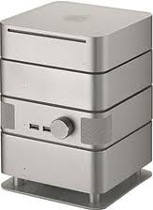
The Legacy Solution
Accounting
ETL
ETL
Finance
Operations
The Data Warehouse

Slide 5
Problems with Legacy Solution
Data collection is Expensive
Data is Rigid
Data generally stale when collected for processing
Result
Scaling up costs lots of money

Slide 6
Alternate Solution
‘Scale out’ instead of ‘Scale up’
Horizontally instead of Vertically
Processing nodes
0100100101010
Node A
Node B

Slide 7
Issues with disk seek in traditional horizontal scaling
Disk seek
100 Billion records x 10 bytes = 1 TB
To update 10% of records would mean updating 10 billion records
Traditional approach in classical systems:
Seek, read, write
Seek is slowest with average cost of 10ms (needs physical movement of head)
A seek for every record would take 2,700 hours
A scan read would take about 10,000 seconds (2.7 hours)
More seek – make the numbers go even higher

Slide 8
Classical systems - Assumptions
Hardware is reliable – won’t fail. System would fail if one piece of hardware fails.
Machines have an identity
Data sets must be centralized
NOT TRUE ANY MORE

Slide 9

Lab 1
Goal: Log in to remote terminal
ssh to your remote machine
go to your home directory
verify the contents of your home directory
login and password will be provided by instructor
All labs will be performed on your remote machine
Use an editor like vi or emacs to create or edit files in all future labs

Slide 10
Apache Hadoop – A Developer’s Course
Hadoop Basics – HDFS and MapReduce

Slide 11
New Paradigm
Process data locally
Reduce dependence on bandwidth
Expect failure
Handle failover elegantly
Duplicate finite blocks of data to small groups of nodes instead of entire database
Reduce elapsed seek time

Slide 12

The Hadoop Approach
HDFS – is Hadoop Distributed File System
HDFS provides storage
MapReduce – a distributed analysis method
MapReduce provides analysis power
Distribute large amounts of data across thousands of commodity hardware nodes
Process data in parallel
Replicate data across cluster for reliability
Analysis moved to data
Avoids data copy
Scanning of data
Avoids random seeks
Easiest way to process

Slide 13
Hadoop Scalability
Rate: ~170 Mbps/node

Slide 14

History of Hadoop
Source http://hadoopilluminated.com/hadoop_book/chapter-Hadoop_Versions.html

Slide 15
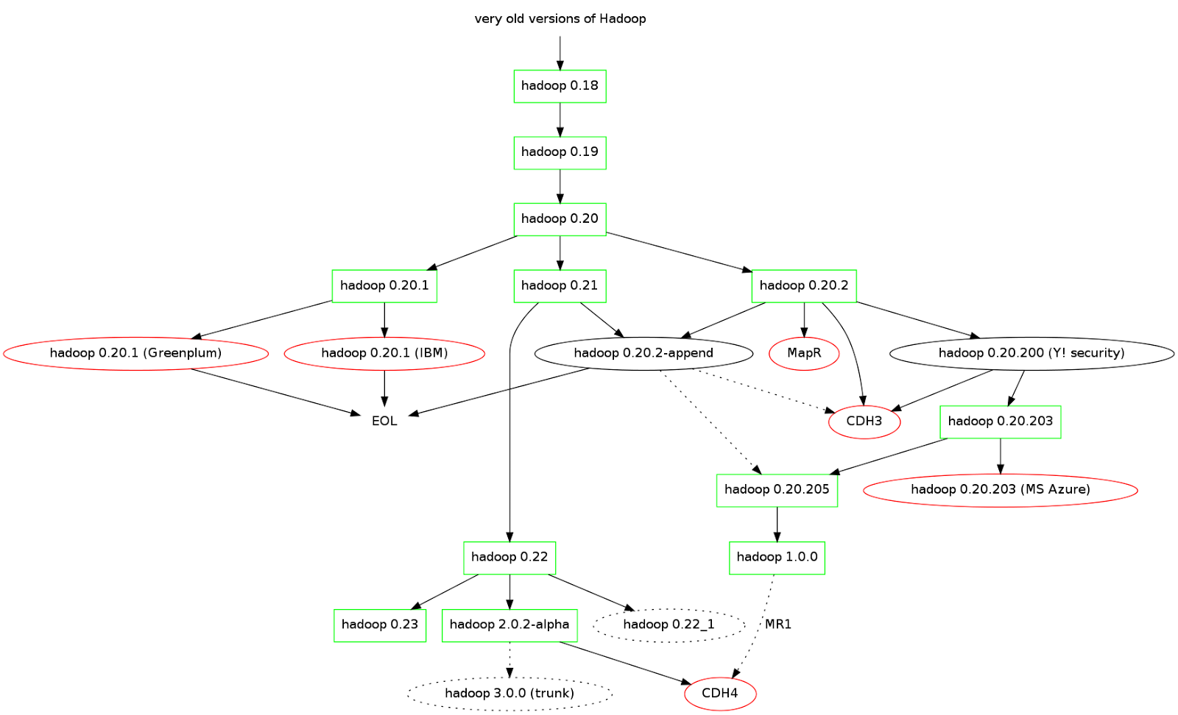
Hadoop versions and branches
Genealogy of Elephants II: http://drcos.boudnik.org/2013/01/what-you-wanted-to-know-about-hadoop.html

Slide 16

Hadoop Ecosystem

Slide 17
Apache Hadoop – A Developer’s Course
Working with HDFS

Slide 18
HDFS – An Introduction
HDFS = Hadoop Distributed File System
Primary storage for Hadoop
Fast and reliable
Deployed only on Linux so far (Windows in the works)
Characteristics of HDFS
Persistent
Replicated
Linearly scalable
Applications sequentially stream reads – often from very large files
Optimized for read performance – avoids random disk seeks
Write once and read many times
Files only append
Data stored in blocks distributed over many nodes with block sizes from 128MB to 1GB

Slide 19
HDFS Architecture
NameNode
Secondary NameNode
Namespace
Namespace
Block Management
Block Management
Block Map
Block Map
Namespace MetaData Image (Checkpoint) & Edit Journal Log
Checkpoints Image and Edit Journal Log (backup)
DataNode
DataNode
DataNode
BL1
BL6
BL1
BL3
DataNode
BL2
BL7
BL6
BL2

Slide 20
Data Organization
Metadata
Organized into files and directories
Linux-like permissions prevent accidental deletions
Files
Divided into uniform sized blocks
Default 64 MB
Distributed across clusters
Rack-aware
Keeps sizing checksums
for corruption detection

Slide 21
HDFS Cluster
HDFS runs in Hadoop distributed mode
on a cluster
3 main components:
NameNode
Manages DataNodes
Keeps metadata for all nodes and blocks
DataNodes
Hold data blocks
Live on racks
Client
Talks directly to NameNode and then DataNodes

Slide 22
NameNode
Server running the Namenode daemon
Responsible for coordinating datanodes
The ‘master’ of the DataNodes
Problems
Lots of overhead to being the Master
Should be special server for performance
Single point of failure

Slide 23
Secondary NameNode
Not really an automatic secondary – named poorly!
NO auto-failover
Must be configured
Merges and manages two files
Filesystem image (fsimage)
Edit log
Sends resulting metadata back to NameNode
Should run on a separate Node

Slide 24
DataNode
A common node running a datanode daemon
Slave
Manages block reads/writes for HDFS
Manages block replication
Pings NameNode and gets instructions back
If heartbeat fails
NameNode removes from cluster
Replicated blocks take over

Slide 25
HDFS Heartbeats
NameNode
fsimage
I am DataNode X and my new blocks are …
editlog
DataNode daemon
DataNode daemon
DataNode daemon
DataNode daemon
DataNode daemon
HDFS

Slide 26
File Access - RPC
NameNode
1
JVM
Pig
Namespace
2
Distributed File System
3
Hive
Block Management
Client Code
4
HBase
Block Map
FSDataOutput/Input Stream
fsshell
Request (create/open/delete) - Provide name of file or directory
Approval
Request for block
Block ID and list of DataNodes
Operation on DataNode - Read - Write - Delete
Return
5
6
DataNode
NameNode is not in data path
NameNode only stores metadata

Slide 27
HDFS Shell Commands
$ hadoop fs –command <args>
HDFS command examples (around 30 commands)
-cat: display file contents (uncompressed)
-text: like cat, but works on compressed files
-chgrp, -chmod, -chown: just like the Unix command, changes permissions
-put, -get, -copyFromLocal, -copyToLocal: copies files from the local file system to HDFS and vice-versa.
-ls, -lsr: lists files / directories
-mv, -moveToLocal, -moveFromLocal: moves files
-stat: statistical info for any given file (block size, number of blocks, file type, etc.)

Slide 28
HDFS Command Examples
$ hadoop fs –ls /user/john $ hadoop fs –lsr
$ hadoop fs –mkdir input $ hadoop fs –put ~/training/commands.txt notes $ hadoop fs –chmod 777 notes/command.txt $ hadoop fs –cat notes/commands.txt | more $ hadoop fs –rm notes/*.txt

Slide 29
Uploading and Retrieving files on HDFS
Uploading
Retrieving
$ hadoop fs –put filenameSource filenameDestination $ hadoop fs –put filename directoryName/fileName
$ hadoop fs –put foo bar $ hadoop fs –put foo directoryName/fileName $ hadoop fs –lsr directoryName
$ hadoop fs –cat foo $ hadoop fs –get foo LocalFoo $ hadoop fs –copyToLocal foo LocalFoo
$ hadoop fs –rmr directory/file

Slide 30
Lab 2: Get familiar with HDFS commands
Practice basic HDFS file-system commands

Slide 31
HDFS APIs
Java APIs exists for low-level access to HDFS
Abstracts file-system API
Easy access and storage on HDFS
API hides low-level details about file-system
Package containing APIs org.apache.hadoop.fs
Five interfaces provided
Over 20 classes, enums, exceptions provided, e.g.
FileSystem
Path
BlockLocation
FileChecksum

Slide 32
Core types found in .fs Package
Path
Wraps a directory or file
Uses “/” as a path separator
FileSystem
Represents either distributed HDFS of Local Linux OS file system (determined by factory method)
FSDataInputStream and FSDataOutputStream
Handles File I/O
FileStatus
Provides directory or file metadata
e.g. group, owner, directory flag etc.

Slide 33
Path – allows path handling
Path – represents and HDFS file or directory
Used by FileSystem object at runtime
Path has 7 constructors and over a dozen methods
FileSystem hadoop = FileSystem.get(new Configuration());
Path myPath = new Path(hadoop.getWorkingDirectory(), “/logdata”);
hadoop.mkdirs(myPath); // creates with default permissions
boolean wasDeleted = hadoop.deleteOnExit(myPath);
Example of how to create an HDFS directory

Slide 34
FileSystem – a class to represent file system
FileSystem – represents the HDFS or local file system
No public constructor
Dozens of methods available
Use public static factory methods to get an instance
LocalFileSystem getLocal(Configuration conf)
FileSystem get(Configuration conf)
FileSystem get(URI uri, Configuration conf)
FileSystem get(URI uri, Configuration conf, String user)
FileSystem hdfs = FileSystem.get(new Configuration());

Slide 35
FileStatus – a class for metadata
FileStatus – represents metadata for HDFS or a directory
public Path getPath()
Once Path is known, the file can be read
Retrieve other data like length, modification time, permissions, etc.
Returned by FileSystem methods
public FileStatus[] getFilesByDir(Path hdfsDir, FileSystem hdfs) {
FileStatus[] allFiles = hdfs.listStatus(hdfsDir);
return allFiles; }

Slide 36
Using HDFS API – example to copy a file
public void showHDFS(Path inPath, Path outPath) throws IOException {
Configuration config = new Configuration();
FileSystem hdfs = FileSystem.get(config); //call static factory method
LocalFileSystem local = FileSystem.getLocal(config); // local Linux file
FSDataInputStream inStream = local.open(inPath); // read data
FSDataOutputStream outStream = hdfs.create(outPath); //open out stream
byte[] bytesRead = new byte[1000]; // to hold file data in memory
int data = 0; // counter to read input file
while ((data = inStream.read(bytesRead)) > 0 {
System.out.println("Reading input file: " + inPath); // report file name outStream.write(bytesRead); // write data to output stream
}
inStream.close(); // close the input stream
outStream.close(); // close the output stream
}
Copies a file from local file system to HDFS

Slide 37
Hadoop Configuration files
Three configuration files (Hadoop v0.2 and beyond)
core-site.xml for core settings
e.g. hostname for NameNode deamon
hdfs-site.xml for HDFS issues
e.g. how a data block replicates to DataNodes
mapred-site.xml for MapReduce issues
e.g. hostname for the JobTracker daemon
Environment configuration stored in hadoop-env.sh
e.g. JAVA_HOME
Notes:
Earlier versions of Hadoop stored all configuration data in just one file - hadoop-site.xml

Slide 38
Lab 3: Program HDFS
Goal: Use Java to accomplish HDFS tasks
Procedure:
Read a file from local Linux filesystem
Write a file to the HDFS

Slide 39
Monitoring HDFS
Web Interface
NameNode can be accessed from port 50070
http://namenode:50070
Provides basic monitoring and file browsing operations
DataNode can be accessed by using port 50075
http://datanode:50075
HDFS Log Files
Hadoop in distributed modes uses log files
The following daemons create logs
namenode
secondarynamenode
datanode
jobtracker
tasktracker

Slide 40
HDFS File Permissions
Simple permission system based on POSIX model
Does not provide strong security for HDFS
Designed to prevent accidental corruption of data or casual misuse of information
Users and Groups defined
Each file or directory has 3 permissions
Read, write and execute
Superuser supersedes all permission settings

Slide 41
Lab 4: Monitor HDFS
Goal: Practice using basic monitoring tasks in HDFS and explore various configurations and variables
Procedure:
Explore NameNode and DataNode configuration
Explore JobTracker and TaskTracker configuration
Use the HDP web-based GUI to browse web user interfaces
Examine Hadoop primary daemons and environmental variables
Start and stop Hadoop services

Slide 42
Apache Hadoop – A Developer’s Course
MapReduce – A Primer

Slide 43
What is MapReduce?
A framework
Big Data analytics and processing
Large datasets
Node-local computation
Parallel processes
Handles node fail-over
Java
Other languages supported

Slide 44
MapReduce Architecture
MapReduce
Node
Node
Input Format
Map
Partitioner
Sort
Reduce
OutputFormat
Distributed File System (HDFS)

Slide 45
Simple MapReduce
Key | Value Key | Value Key | Value Key | Value Key | Value Key | Value Key | Value Key | Value Key | Value
Key | Value Key | Value Key | Value Key | Value Key | Value Key | Value Key | Value Key | Value Key | Value
Key | Value Key | Value Key | Value
Map
Reduce
Key | Value Key | Value Key | Value
Key | Value Key | Value
Input
Intermediate
Result
Represents some type of collection

Slide 46
Splitting data
InputFormat determines how the data is split up
Creates InputSplit[] arrays
Each is individual map
Associated with a list of destination nodes
RecordReader
Makes key, value pairs
Converts data types

Slide 47
Mapping data
Mapping operates on every data set individually
Often used for extraction, transformation and loading (ETL) operations
Key | Value Key | Value Key | Value Key | Value
Runs algorithm on each data row sequentially
map(K1 key, V1 value,
OutputCollector<K2, V2> output,
Reporter reporter)

Slide 48
Partitioner
Partitioner distributes [key, value] pairs
Decides the target Reducer
Uses the key to determine
Uses Hash function by default
Can be overridden with custom function
getPartition(K2 key, V2 value,
int numPartitions);
Map
Reduce
The Shuffle
Map
Reduce
Map

Slide 49
Sort operation
Sort guarantees sorted inputs to Reducers
Final step of Shuffle
Helps to merge Reducer inputs

Slide 50
Reduce
Receives output from multiple Mappers
Consolidates values for common intermediate keys
Groups values by key
reduce(K2 key,
Iterator<V2> values,
OutputCollector<K3, V3> output,
Reporter reporter);

Slide 51
OutputFormat
OutputFormat is a validator
for output specifications
Sets up a RecordWriter
Which writes out to HDFS
Organizes output into part-r-0000x files

Slide 52

Configuring Hadoop using Properties
Hadoop has hundreds of properties
Some are related to HDFS
Some are related to MapReduce
Some are related to system as a whole
Source code is best source to find properties
One can create own properties too
<property>
<name>dfs.blocksize</name>
<value>67108864</value>
<description>
The default block size for new files, in bytes.
</description>
</property>
<property>
<name>mapreduce.output.fileoutputformat.compress</name>
<value>false</value>
<description>Should the job outputs be compressed?
</description>
</property>
<property>
<name>io.file.buffer.size</name>
<value>4096</value>
<description>The size of buffer for use in sequence files.
The size of this buffer should probably be a multiple of hardware
page size (4096 on Intel x86), and it determines how much data is
buffered during read and write operations.</description>
</property>
See more at http://hadoop.apache.org/docs/current/hadoop-project-dist/hadoop-hdfs/hdfs-default.xml

Slide 53
Apache Hadoop – A Developer’s Course
Programming MapReduce

Slide 54
WordCount – A Classic Example
Input file kept in folder /user/yourname/input
Output is generated in folder /user/yourname/output
public class WordCount {
/**
* The mapper extends from the org.apache.hadoop.mapreduce.Mapper interface. When Hadoop runs,
* it receives each new line in the input files as an input to the mapper. The "map" function
* tokenize the line, and for each token (word) emits (word,1) as the output.
*/
public static class TokenizerMapper
extends Mapper<Object, Text, Text, IntWritable>{
}
/**
* Reduce function receives all the values that has the same key as the input, and it output the key
* and the number of occurrences of the key as the output.
*/
public static class IntSumReducer
extends Reducer<Text,IntWritable,Text,IntWritable> {
}
/**
* As input this program takes any text file. Create a folder called input in HDFS (or in local directory if you are running this locally)
* @param args
* @throws Exception
*/
public static void main(String[] args) throws Exception {
}
}

Slide 55
map() method of a basic MapReduce job
/**
* The mapper extends from the org.apache.hadoop.mapreduce.Mapper
* interface. When Hadoop runs, it receives each new line in the input files
* as an input to the mapper. The "map" function tokenize the line, and for
* each token (word) emits (word,1) as the output.
*/
public static class TokenizerMapper
extends Mapper<Object, Text, Text, IntWritable>{
private final static IntWritable one = new IntWritable(1);
private Text word = new Text();
public void map(Object key, Text value, Context context) throws
IOException, InterruptedException {
StringTokenizer itr = new StringTokenizer(value.toString());
while (itr.hasMoreTokens()) {
word.set(itr.nextToken());
context.write(word, one);
}
}
}

Slide 56
reduce() method of a basic MapReduce job
/**
* Reduce function receives all the values that has the same key
* as the input, and it output the keyand the number of occurrences
* of the key as the output.
*/
public static class IntSumReducer
extends Reducer<Text,IntWritable,Text,IntWritable> {
private IntWritable result = new IntWritable();
public void reduce(Text key, Iterable<IntWritable> values,
Context context
) throws IOException, InterruptedException {
int sum = 0;
for (IntWritable val : values) {
sum += val.get();
}
result.set(sum);
context.write(key, result);
}
}

Slide 57
main() for a basic MapReduce job
/**
* As input this program takes any text file. Create a folder called input in
* HDFS (or in local directory if you are running this locally)
* @param args
* @throws Exception
*/
public static void main(String[] args) throws Exception {
JobConf conf = new JobConf();
String[] otherArgs = new GenericOptionsParser(conf,
args).getRemainingArgs();
if (otherArgs.length != 2) {
System.err.println("Usage: wordcount <in> <out>");
System.exit(2);
}
Job job = new Job(conf, "word count");
job.setJarByClass(WordCount.class);
job.setMapperClass(TokenizerMapper.class);
//job.setCombinerClass(IntSumReducer.class); //Uncomment for combiner
job.setReducerClass(IntSumReducer.class);
job.setOutputKeyClass(Text.class);
job.setOutputValueClass(IntWritable.class);
FileInputFormat.addInputPath(job, new Path(otherArgs[0]));
FileOutputFormat.setOutputPath(job, new Path(otherArgs[1]));
System.exit(job.waitForCompletion(true) ? 0 : 1);
}

Slide 58
Lab 5: Run an existing MapReduce job
Goal: Run a simple MapReduce job
Procedure:
Use Hadoop built-in map() and Hadoop built-in reduce() code
Review the code for Job setup and configuration
Configuration() class, JobConf() class, and JobClient() class
Run the job

Slide 59
MapReduce life-cycle
NameNode
1. Clients gets metadata
Client
2. Client configs job and starts it
TaskTracker
3. JobTracker informs TaskTrackers
JobTracker
TaskTracker
4.TaskTrackers update job status
TaskTracker
TaskTracker

Slide 60
JobTracker
A “master” daemon of MapReduce
along with NameNodes
Provides resource management
Manages TaskTrackers at each node
Schedules tasks to available resources
Manages Job lifecycle
Job submission
Task execution
Task error recovery
Run job’s tasks to completion

Slide 61
TaskTracker
Is a node-level daemon
Manages tasks at the node
Talks with JobTracker
Gets new tasks
Provides updates
Typically fetches executables from HDFS
Has slots
One task per slot

Slide 62
Job Submission and Running
NameNode
1
Client
2
3
5
JobTracker
4
8
7
Send config and jars
Request location of data
Obtain location of data
Submit job
Requests InputSplits
Send task to TaskTransfer
Request for job related info
Send job related info
Run tasks
Report about tasks
10
6
TaskTracker
9
Task
Task
DataNode

Slide 63
Hadoop Job Submission
$ hadoop fs myMapReduce.jar com.mycompany.hadoop.MyJob inputFile outputDirectory
-Dproperty=value –conf path & file –fs some uri -files
Invocation options:
$ hadoop jar myMapreduce.jar MyJob arg1 arg2
// config job in main
public static void main(String[] args)
// call run() from main()
public static void main(String[] args)
ToolRunner.run(MyClass, args)

Slide 64
ToolRunner
Handles command-line arguments
Job config is in run() method
main() now calls ToolRunner
Invokes your run() method
Needs to know the class holding your run method, and the command line arguments
Passes parameters to run() via a Configuration object

Slide 65
Tool Interface
When Tool is implemented you also get GenericOptionsParser
A class that interprets Hadoop command-line options
Sets them in a Configuration object
run() method gets Configuration using getConf()
public interface Tool extends Configurable {
int run(String[] args) throws Exception;
}

Slide 66
Job Configuration
JobConf defines Hadoop job properties
Reads a Configuration() instance to get some of those properties
Assigns a job name
Specifies key/value data types for map and reduce
Assigns map and reduce runtime classes
Specifies HDFS input and output directories

Slide 67
JobConf() properties
Implements <<Iterable<Map.Entry<String, String>> >>
Configuration
Reads and stores properties as pairs of Strings. Has a variety of get and set methods.
core-site.xml
extends
JobConf
Setup information for a Job.
mapred-site.xml

Slide 68
Some JobConf() Methods
job.setJobName(“Log Processing Job”);
job.setMapperClass(Mapper.class);
job.setReduceClass(Reducer.class);
job.setOutputKeyClass(Text.class); // to HDFS from reduce()
job.setOutputValueClass(Text.class); // to HDFS from reduce()
job.setCombinerClass(Reducer.class);
job.setJarByClass(PageStat.class);
job.setMapOutputKeyClass(Text.class); // output from map()
job.setMapOutputValueClass(IntWritable.class); // from map()
job.setNumReduceTasks(1);
job.set(String name, String value); // set arbitrary property
String jobName = job.get(String name);
Full set may be found at http://hadoop.apache.org/docs/r1.2.0/api/org/apache/hadoop/mapred/JobConf.html

Slide 69
Chaining Jobs
Job 1
Job 2
HDFS
EDW
Unstructured
Semi-structured
Structured
Data Warehouse
General mechanism to chain jobs for any problem solution

Slide 70
Fault Tolerance
TaskTracker sends heartbeats to the JobTracker
If the TaskTracker fails during Map process
Other TaskTrackers will be assigned
Re-execute all tasks
If the TaskTracker fails during Reduce process
Other TaskTrackers will be assigned
Re-execute only incomplete tasks

Slide 71
Output Files
Number of reducers is configurable
number of output files = number of reducers
One-to-one reducer to output file
One can specify the number of reducers in code JobConf.setNumReduceTasks()
A map-only job
Specify number of reducers to be zero
number of output files = number of mappers = number of input blocks
Override InputFormat.getSplits() to control the number of map tasks

Slide 72
Killing a job
Runaway jobs can be killed with a "job –kill" command
$ mapred job -list
0 jobs currently running
JobId State StartTime UserName Priority SchedulingInfo
job_201305162210_0001 4 1368767710835 shrek NORMAL NA
$ mapred job –kill job_201305162210_0001

Slide 73
Lab 6: Write a simple MapReduce job
Goal: Write a MapReduce program to count the occurrences of distinct words
Procedure:
Create an input file and copy it to HDFS
Create a java file that adds the Java and Hadoop imports, the MapReduce class and sub-classes, map and reduce methods, and specify other aspects of the job
Compile and run the program

Slide 74
Apache Hadoop – A Developer’s Course
Hadoop Data Types

Slide 75
Hadoop Built-in classes
Simple implementations of map() and reduce()
simple e.g. reverse K,V mapper
map() "pass through"
copies K,V input as K,V output
still groups by key
sends the grouped data to a reducer
reduce() "pass through"
pulls out each V from the Iterator and creates a KV pair
KV pairs are sent as output to HDFS

Slide 76
A Writable Datatype
public class MyWritable implements Writable {
// Some data
private int counter;
private long timestamp;
public void write(DataOutput out) throws IOException {
out.writeInt(counter);
out.writeLong(timestamp);
}
public void readFields(DataInput in) throws IOException {
counter = in.readInt();
timestamp = in.readLong();
}
public static MyWritable read(DataInput in) throws IOException {
MyWritable w = new MyWritable();
w.readFields(in);
return w;
}
}
Example of a Writable class

Slide 77
Writable interface
Methods
write(DataOutput out)
readFields(DataInput in)
DataInput and DataOutput are streaming datatypes
methods that can be used on those streams
e.g. readInt(), writeInt(), readLong(), writeLong()
I/O on those streams is Hadoop-specific
API docs available at:
http://hadoop.apache.org/docs/r1.2.0/api/org/apache/hadoop/io/Writable.html
http://java.sun.com/javase/6/docs/api/java/io/DataInput.html
http://java.sun.com/javase/6/docs/api/java/io/DataOutput.html

Slide 78
WritableComparable / RawComparator
WritableComparable
Interface for objects that are both Writable and Comparable
Same methods as Writable
plus compareTo method
Make your keys implement this interface
API docs: http://hadoop.apache.org/docs/r1.2.0/api/org/apache/hadoop/io/WritableComparable.html
RawComparator
Compares keys by bytes during the sorting phase of MapReduce
Avoids the overhead of keys being deserialized
Improves performance greatly
Write your own class that implements RawComparator or extends WritableComparator class
API docs: http://hadoop.apache.org/docs/r1.2.0/api/org/apache/hadoop/io/RawComparator.html

Slide 79
WritableComparator
Utility class to simplify implementing RawComparator
public class MyComparator extends WritableComparator {
protected MyComparator() {
super(MyKey.class);
}
@Override
public int compare(byte[] b1, int s1, int l1, byte[] b2, int s2, int l2) {
// Return 0 if b1 and b2 are equal
// Return a negative value if b1 < b2
// Return a positive value if b1 > b2
}
}
b1 - The first byte array.
s1 - The position index in b1. The object under comparison's starting index.
l1 - The length of the object in b1.
b2 - The second byte array.
s2 - The position index in b2. The object under comparison's starting index.
l2 - The length of the object under comparison in b2.
API docs: http://hadoop.apache.org/docs/r1.2.0/api/org/apache/hadoop/io/WritableComparator.html

Slide 80
WritableComparable Example
public class MyWritableComparable implements WritableComparable {
// Some data
private int counter;
private long timestamp;
public void write(DataOutput out) throws IOException {
out.writeInt(counter);
out.writeLong(timestamp);
}
public void readFields(DataInput in) throws IOException {
counter = in.readInt();
timestamp = in.readLong();
}
public int compareTo(MyWritableComparable w) {
int thisValue = this.value;
int thatValue = ((IntWritable)o).value;
return (thisValue < thatValue ? -1 : (thisValue==thatValue ? 0 : 1));
}

Slide 81
Basic Writable Datatypes
Sub-classes generally support .get(), .set(), and .toString()
Examples
ByteWritable
IntWritable
LongWritable
FloatWritable
DoubleWritable
BooleanWritable
NullWritable (with no .set() function)
IntPairWritable
Text
See full set in API docs: http://hadoop.apache.org/docs/r1.2.0/api/org/apache/hadoop/io/Writable.html

Slide 82
Writable Collections
ArrayWritable for a Java Array
myArrayWritable.set(Writable[])
myArrayWritable.get() – returns a Writable object
myArrayWritable.toArray() – returns a Java object
MapWritable for a Java HashMap
myMayWritable.put(K, V)
myMayWritable.get(K)
BytesWritable for a Java array of bytes
myByteWritable.set(byte[], offset, len)
myByteWritable.get() - returns a byte array byte[]
API docs:
http://hadoop.apache.org/docs/r1.2.0/api/org/apache/hadoop/io/ArrayWritable.html
http://hadoop.apache.org/docs/r1.2.0/api/org/apache/hadoop/io/MapWritable.html
http://hadoop.apache.org/docs/r1.2.0/api/org/apache/hadoop/io/BytesWritable.html

Slide 83
Other Serialization Options
Apache Thrift (http://thrift.apache.org/)
Avro (http://avro.apache.org/)
Google Protocol Buffers (http://code.google.com/p/protobuf/)

Slide 84
Lab 7: Create a custom Writable Type
Goal: Create a new Hadoop datatype that can be passed as a value between your map() and reduce() code. It can be serialized to disk or transmitted across the network.

Slide 85
Apache Hadoop – A Developer’s Course
InputFormat, OutputFormat, Combiner and Partitioner

Slide 86
InputFormat
Identifies input type
Can be anything like
Text
Numbers
Complex types
DB rows
Defines the way input files are chopped up
getSplits()
Individual records come from splits
getRecordReader()
Parses input split into a set of key/value pairs

Slide 87
TextInputFormat
MapReduce
Node
K,V
Input Format
Map
"To be or" "not to be"
0
9
Distributed File System (HDFS)
To be or↵
not to be↵

Slide 88
TextInputFormat
K = offset = 64MB – 2
V = "is the question"
Node
Node
HDFS
To be or↵
not to be↵
...........
...........
is
the question↵
"Value" of a "key" can span over multiple blocks
Notes:
Question: Can it span over multiple data nodes?

Slide 89
FileInputFormat
FileInputFormat used for large files
Larger than HDFS block
Split size
Controlled by Hadoop properties
Can be overridden by Application
Hadoop is optimized by
decreasing the number of files and
making size of files larger

Slide 90
InputSplits and HDFS
Split is a portion of the data to be processed by a single map process in parallel
Split = single block of data
records may straddle blocks
tasks often need to access a small portion of a record from a block on another node
Use larger blocks for a split to:
Increase performance due to more data for a mapper
A mapper has setup/teardown time that is constant
A small split means less work for the constant setup time
JobClient computes input splits

Slide 91
InputSplit
Usually crosses boundaries
of Mappers
of HDFS blocks
Split 0
\n
Map 0
\n
Split 1
\n
Map 1
\n
\n
Split 2
Map 2
\n
\n
Split 3
\n
Map 3

Slide 92
RecordReader
The RecordReader breaks the data into key/value pairs for input to the Mapper
public interface RecordReader<K, V> {
/* Reads the next key/value pair from the input for processing. */
boolean next(K key, V value) throws IOException;
/* Create an object of the appropriate type to be used as a key. */
K createKey();
/* Create an object of the appropriate type to be used as a value. */
V createValue();
/* Returns the current position in the input. */
long getPos() throws IOException;
/* Close this {@link InputSplit} to future operations. */
public void close() throws IOException;
/* How much of the input has the {@link RecordReader} consumed i.e.
has been processed by? */
float getProgress() throws IOException;
}
API docs: http://hadoop.apache.org/docs/r1.2.0/api/org/apache/hadoop/mapred/RecordReader.html
Notes:
RecordReader reads <key, value> pairs from an InputSplit.
RecordReader, typically, converts the byte-oriented view of the input, provided by the InputSplit, and presents a record-oriented view for the Mapper & Reducer tasks for processing. It thus assumes the responsibility of processing record boundaries and presenting the tasks with keys and values.

Slide 93
RecordReader – split vs. record
K
V
K
V
K
V
K
V
Block A (64 MB)
Block B (64 MB)
RecordReader
RecordReader
Mapper 1
Mapper 2
Notes:
HDFS is block-oriented. MapReduce is record oriented. RecordReader converts block-oriented data to record-oriented data in order to feed into the Mapper.

Slide 94
Binary Input
SequenceFileInputFormat
Stores binary keys and values
Can be split
Can be compressed
Has many types
Some variants exist
SequenceFileAsTextInputFormat
SequenceFileAsBinaryInputFormat

Slide 95
OutputFormat
Output files are all placed in the same directory for a job
By default they are named part-r – with a five digit number
Numbering starts with part-r-00000
The numbering corresponds to the reducer number
$ hadoop fs -ls /user/shrek/output
Found 4 items
-rw-r--r-- 1 shrek supergroup 0 2013-05-07 07:02 /user/shrek/output/_SUCCESS
drwxr-xr-x - shrek supergroup 0 2013-05-07 07:00 /user/shrek/output/_logs
-rw-r--r-- 1 shrek supergroup 43881658 2013-05-07 07:01 /user/shrek/output/part-r-00000
-rw-r--r-- 1 shrek supergroup 42978232 2013-05-07 07:01 /user/shrek/output/part-r-00001

Slide 96
Lab 8: Create a custom InputFormat
Goal: Write an InputFormat that can read input files that are not lines of strings

Slide 97
Combiner
An optional component
It is a map-side "mini-reducer"
Operates only on one map's data
Reduces the amount of data to be shuffled
Across the wire
Should reduce the number of records
Caution: Works only for commutative and associative functions
Mapper
InputFormat
Map
Combiner
Partitioner

Slide 98
Map-side Reducer
Mapper
InputFormat
Map
Combiner
Partitioner
Shuffle
RAM
Spill to disk

Slide 99
Map-Side Reducer
Mapper
InputFormat
Map
Combiner
Partitioner
Shuffle
k,v k,v
1
{{k, 2v},
{k, 3v},
{k, v}}
k,v k,v kv
2
k,v
3

Slide 100
Combiner Contract
Implements the Reducer interface
Reducer's input pairs must be the same type as Map output
Can run 0 to multiple iterations
Cannot assume that incoming list is fully sorted data
Cannot change the values of the keys
Reduce
Mapper
Shuffle
Reduce
InputFormat
Map
Partitioner
Combiner
Reduce
Key | Value Key | Value Key | Value

Slide 101
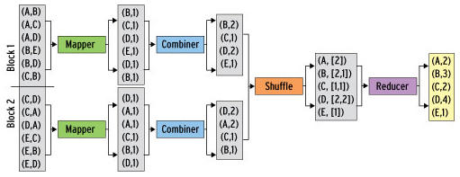
Combiner in Action
The use of a combiner makes sense for arithmetic operations in particular.
Source: http://www.admin-magazine.com/HPC/Articles/MapReduce-and-Hadoop
Notes:
Count the number of "values" in this exercise

Slide 102
Combiner Cautions
Should show repeatable results
No matter how many times it is run
Combiners are slow
Compare MAP_OUTPUT_RECORDS without Combiner to COMBINER_OUTPUT_RECORDS with the Combiner
MAP_OUTPUT_RECORDS should be far greater than the COMBINER_OUTPUT_RECORDS
Make sure the combiner does not cause any needed data to be dropped
Works only for functions that satisfy Commutative and Associative property

Slide 103
Lab 9: Use combiner with MapReduce
Goal: Use the combiner to enhance performance of the job

Slide 104
Partitioner Contract
Partitions the key space.
Partitioner controls the partitioning of the keys of the intermediate map-outputs.
Partitioner allocates data across the number of partitions that you specify
Key hash value determines the reducers
HashPartitioner.getPartition()
Can customize to ensure specific reducer targets
The total number of partitions is the same as the number of reduce tasks for the job
API Docs: http://hadoop.apache.org/docs/r1.2.0/api/org/apache/hadoop/mapred/Partitioner.html

Slide 105
Default Partitioner
Key's hashcode() is used
Converted to a positive value
Returns a number from 0 to (# of Reducers minus1)
Works on most keys
May distribute unevenly
If keys hash to similar values
Customize to load-balance

Slide 106
HashPartitioner Class
/** Partition keys by their {@link Object#hashCode()}. */
public class HashPartitioner<K2, V2> implements Partitioner<K2, V2> {
public void configure(JobConf job) {}
/** Use {@link Object#hashCode()} to partition. */
public int getPartition(K2 key, V2 value,
int numReduceTasks) {
return (key.hashCode() & Integer.MAX_VALUE) % numReduceTasks;
}
}
API docs: http://hadoop.apache.org/docs/r1.2.0/api/org/apache/hadoop/mapreduce/lib/partition/HashPartitioner.html

Slide 107
Partitioner Example
Key | Value | Partition
A | ... | 0
B | ... | 1
C | ... | 2
D | ... | 3
E | ... | 4
F | ... | 5
G | ... | 6
H | ... | 7
I | ... | 8
J | ... | 9
K | ... | 0
L | ... | 1
M | ... | 2
...
The developer needs to know the key space
Sampling the data can help to create the understanding.
This could be divided up separately. For example 'S' might be broken up to go to several reducers. Sa to Sh 0 Si to Sm 1 Sn to Sz 2

Slide 108
Lab 10: Create a custom Partitioner
Goal: Write a MapReduce Java program that uses a custom partitioner
Procedure:
Create AlphabeticalPartitioner class
Configure Hadoop to use your custom partitioner and to have 26 reducers
Compile and run the program

Slide 109
Apache Hadoop – A Developer’s Course
Streaming

Slide 110
Streaming
Hadoop streaming allows us to create and run MapReduce jobs with any executable or script
Typically a scripting language is used
Supports Unix commands as mapper or reducer
awk, sed, grep
Supports scripting languages such as:
Python
Perl
Supports other languages such as:
C#

Slide 111
Uses of Streaming
Useful for
Short MapReduce programs
more easily written in other languages
Quick answers
small quickly created data analysis needs
Data is text based
Each line read as a record
Integration with legacy languages

Slide 112
Streaming
MapReduce
Node
Node
Input Format
Map
Partitioner
Sort
Reduce
OutputFormat
STDIN
STDOUT
STDIN
STDOUT
Map (Non-Java)
Reduce (Non-Java)

Slide 113
Streaming Syntax
Look for the streaming classes in the contrib directory
Use built-in Unix commands to process data
Examples: wc, cat
A script using combination of above commands
$ hadoop jar /usr/lib/hadoop-mapreduce/hadoop-streaming.jar -input inputfile -output outputfile -mapper myScript.py
-file myScript.py
-reducer /bin/somecommand

Slide 114
Streaming and Key-value pairs
Streaming can operate on key/value pairs
Uses the tab character as a separator
Default way to separate the key from the value in a record
First value is considered as a key
Remainder of line (excluding tab) is the value
Without a delimiter the entire record is read in as key

Slide 115
Lab 11: Use Python for MapReduce
Goal: Demonstrate MapReduce using a non-Java language such as Python
Procedure:
Examine the Python map application
Ensure that you have map data
Run the streaming job
Display the streaming job

Slide 116
Apache Hadoop – A Developer’s Course
Distributed Cache

Slide 117
Distributed Cache
Distributes application-specific large, read-only files efficiently
Facility provided by Map-Reduce to cache files (text, archives, jars) needed by applications
Specify files via URLs (hdfs:// or http://) to be cached via JobConf
Framework copies files to task nodes
Before the tasks are launched
Files are read-only
Archives are un-archived on the slave
Good for supplemental data
Used locally by mappers and reducers
Often stored on node's Linux file system
Optionally upload from the local file system of the client
Efficient
Once per job (i.e. node) [not once per task]
Many tasks from the same job may run on a single node
API docs: http://hadoop.apache.org/docs/stable/api/org/apache/hadoop/filecache/DistributedCache.html

Slide 118
Shared file access
MapReduce
MapReduce
Avoid accessing blocks from remote node
HDFS
Local File System
Avoid Network I/O by copying file once and keeping on local file system
Notes:
Network I/O increases when MapReduce has to go to a remote node to access data. Distributed cache helps to copy files to a local file on a node per Job and makes it available for every Task in the Job.

Slide 119
Distributed Cache Uses
As a software distribution mechanism
For example to distribute shared objects (.so files)
-files option
allows to provide a comma-separated list of paths
-archive option
allows to distribute .jar, .zip, .tar or .tar.gz files
Decompression of archives is automatic
-libjars option
modifies classpath of the mapper and reducer tasks
Default cache size
is 10GB
can be set with the config local.cache.size ???????
Notes:
In recent versions, there is no local.cache.size. What is the new alternative?

Slide 120
Distributed Cache Uses
Classification
Keywords for documents
City name for zip codes
Distributed data
for Map-side Joins

Slide 121
Cache Deployment
TaskTracker deploys files
From JobTracker's file system to local disks
Before the job is run
Reference count is maintained
For each task that is using each file in cache
JobTracker
File
TaskTracker
TaskTracker
TaskTracker
Task
Task
Task
Task
Task
Task
File
File
File
Node A
Node B
Node C

Slide 122
Using Distributed Cache
Place the file on HDFS
Call the static method DistributedCache.addCacheFile() or DistributedCache.addCacheArchive() to specify the files
Mappers on each individual TaskTracker call method getLocalCacheFiles() to get an array of local file Paths where the local copy is located
The mapper uses Java file I/O techniques to read the local copy
JobTracker
File
TaskTracker
Task
Task
File
Node C

Slide 123
Configure Method
Used to load the cache data into memory when the mapper is first initialized
It is overwritten each time the mapper is initialized
Provides an array of file paths to local copy of files pushed by DistributedCache
Cache file is retrieved using its original name placed relative to the working directory of the task
public static class MyMapClass extends MapReduceBase
implements Mapper<K, V, K, V> {
private Path[] localArchives;
private Path[] localFiles;
public void configure(JobConf job) {
localArchives = DistributedCache.getLocalCacheArchives(job);
localFiles = DistributedCachc.getLocalCacheFiles(job);
}
public void map(K key, V value, OutputCollector<K, V> output,
Reporter reporter) throws IO Exception {
// Use data from the cached archives and files here
}
}

Slide 124
Lab 12: MapReduce with Distributed Cache
Goal: Write a MapReduce program that uses the Distributed Cache
Procedure:
Configure your job to get the local cache file for your mapper
In your Map class, open the File from the Distributed Cache
Tell conf to add the cache file
Compile and run your code

Slide 125
Apache Hadoop – A Developer’s Course
Monitoring and Debugging MapReduce

Slide 126
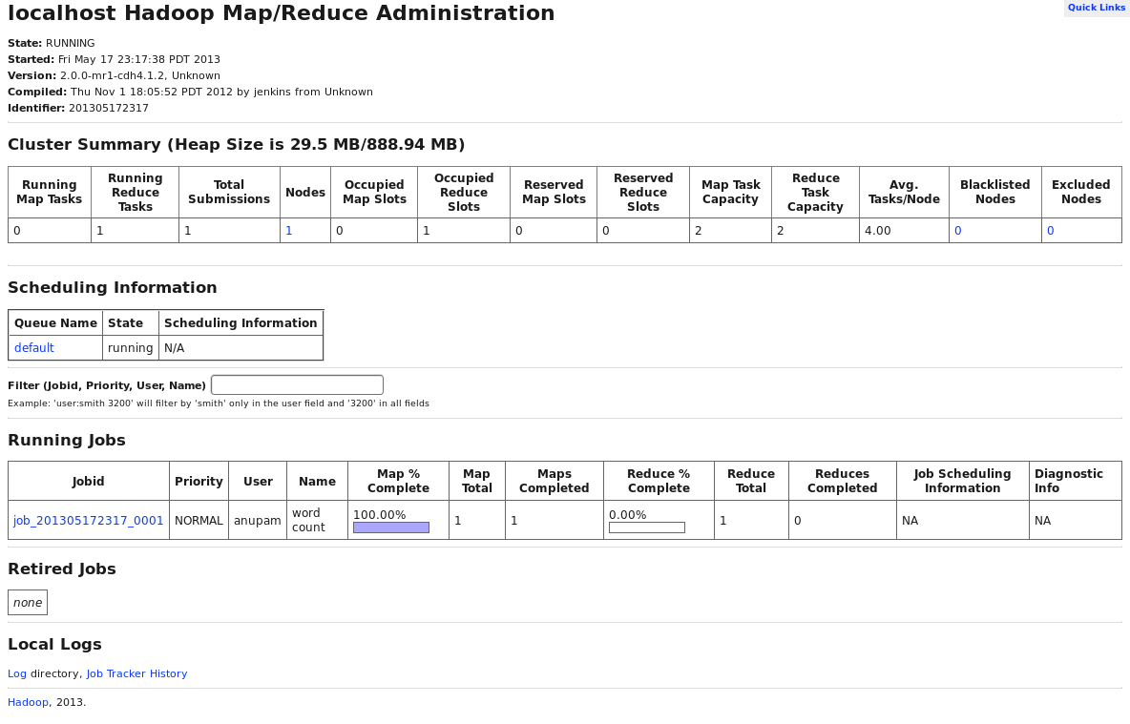
Monitoring a Hadoop job
http://localhost:50030/jobtracker.jsp

Slide 127
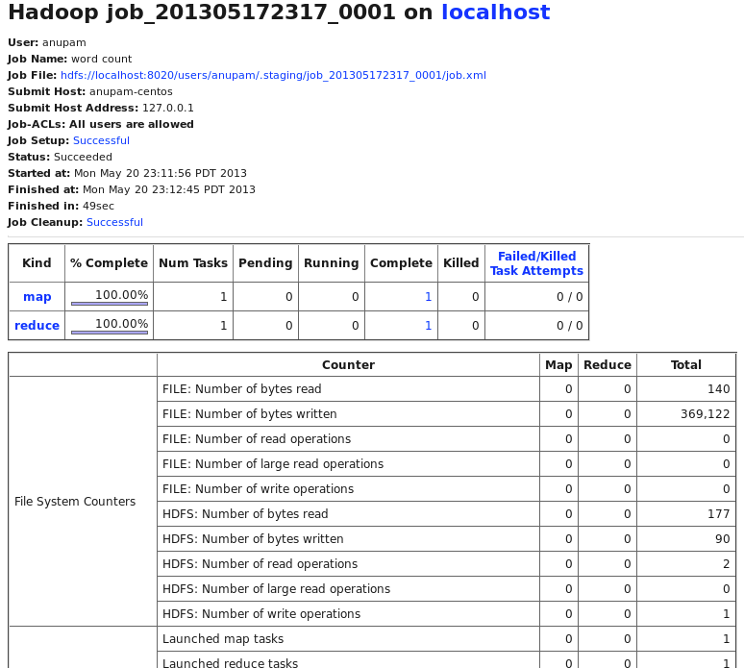
TaskTracker
http://localhost:50030/jobdetails.jsp?jobid=job_201305172317_0001&refresh=30
Drill-down from JobTracker screen

Slide 128
Lab 13: Monitoring a Job with TaskTracker
Goal: Running a MapReduce job and analyze statistics in JobTracker
Procedure:
Run a Java MapReduce program
Use JobTracker GUI to analyze the job

Slide 129
Debugging MapReduce Jobs
Use an IDE to step through
Find the log files under /var/log/hadoop*
Typically hadoop-username-service-hostname.log
Service could be 'jobtracker', 'namenode', 'tasktracker', etc.
For MapReduce jobs, 'tasktracker' is most relevant
TaskTracker logs go to $HADOOP_LOG_DIR/userlogs
Start at JobTracker UI and drill down from there
$ pwd
/var/log
$ ls -al | grep hadoop
drwxrwxr-x. 4 root hadoop 12288 May 20 23:11 hadoop-0.20-mapreduce
drwxrwxr-x. 2 hdfs hadoop 4096 May 17 23:17 hadoop-hdfs
drwxrwxr-x 2 httpfs httpfs 4096 Apr 22 10:36 hadoop-httpfs
drwxrwxr-x 2 mapred hadoop 4096 Apr 22 10:36 hadoop-mapreduce
drwxrwxr-x 2 yarn hadoop 4096 Apr 22 10:36 hadoop-yarn
$ pwd
/var/log/hadoop-0.20-mapreduce/userlogs/job_201305172317_0001
$ ls -al
total 20
lrwxrwxrwx 1 mapred mapred 114 May 20 23:12 attempt_201305172317_0001_m_000000_0 -> /var/lib/hadoop-hdfs/cache/mapred/mapred/local/userlogs/job_201305172317_0001/attempt_201305172317_0001_m_000000_0

Slide 130
Logging
All Hadoop daemons and jobs use log4j
/etc/hadoop/conf/log4j.properties configures cluster-wide
One should use log4j, but with a different configuration file, or a programmable configuration for logging level
Hadoop logs output from System.out.println() and System.err.println()
Stored in files named stdout, stderr and syslog
It is spread around the cluster
Co-located on nodes with TaskTracker daemons
$(HADOOP_LOG_DIR)/userlogs/<subdirs>
$ pwd
/var/log/hadoop-0.20-mapreduce
$ ls -al | grep ^d
drwxrwxr-x. 4 root hadoop 12288 May 21 07:40 .
drwxr-xr-x. 25 root root 4096 May 19 19:01 ..
drwxr-xr-x. 3 mapred mapred 4096 May 20 23:12 history
drwxr-xr-x. 3 mapred mapred 4096 May 20 23:12 userlogs
Notes:
Where are the files stdout, stderr and syslog present?

Slide 131
Finding location of log files
Two methods used
Use the JobTracker GUI and follow the links to see your stdout, stderr and syslog generated by log4j
Write a script to collect logs from the cluster
Links to logs are stored at $HADOOP_LOG_DIR/userlogs
Other userlogs directories kept by each TaskTracker
May cause confusion when you only see a subset of your logs in a given userlogs directory
$ pwd
/var/log/hadoop-0.20-mapreduce/userlogs/job_201305172317_0001/attempt_201305172317_0001_m_000000_0
$ ls -al
total 16
drwx------ 2 mapred mapred 4096 May 20 23:12 .
drwxr-xr-x 6 mapred mapred 4096 May 20 23:12 ..
-rw-r--r-- 1 mapred mapred 143 May 20 23:12 log.index
-rw-r--r-- 1 mapred mapred 0 May 20 23:12 stderr
-rw-r--r-- 1 mapred mapred 0 May 20 23:12 stdout
-rw-r--r-- 1 mapred mapred 1514 May 20 23:12 syslog

Slide 132
Lab 14: Debug MapReduce code
Goal: Write a simple MapReduce program that uses log4j and standard error output (stderr) to debug code

Slide 133
Lab 15: Practice MapReduce use-case
Weather statistics
Stock market statistics

Slide 134
Apache Hadoop – A Developer’s Course
Fundamentals of PIG

Slide 135
Apache Hadoop – A Developer’s Course
Grunt

Slide 136
Apache Hadoop – A Developer’s Course
PIG Latin

Slide 137
Apache Hadoop – A Developer’s Course
Introduction to Hive

Slide 138
Apache Hadoop – A Developer’s Course
Hive Data

Slide 139
Apache Hadoop – A Developer’s Course
Hive Operators and Functions

Slide 140
Apache Hadoop – A Developer’s Course
HCatalog

Slide 141
Apache Hadoop – A Developer’s Course
HBase

Slide 142
Apache Hadoop – A Developer’s Course
HBase Architecture and API

Slide 143
Apache Hadoop – A Developer’s Course
Hadoop Web Services

